Slide 1
Project Title
UE20CS302 – Machine Intelligence
Mini Project
Project Title : Stock Market Predictor
Team No:
Project Guide :
Project Team with SRNs : PES1UG20CS340|PES1UG20CS342|PES1UG20CS345

Slide 2
Problem Statement
The future is unknown and uncertain, but there are ways to predict future events and reap the rewards safely. One such opportunity is the application of machine learning and artificial intelligence for stock market prediction.
The stock market is turbulent, yet using artificial intelligence to make calculated predictions is possible and advisable before investing.
This study presents an overview of artificial intelligence and machine learning as predictive analytics tools in the stock market.
We discuss the strengths and weaknesses of machine learning for stock market prediction and provide some insight into the opportunities and threats in applying advanced technologies for stock market prediction.
Notes:
Provide a basic introduction of the project and also an overview of scope it entails.
Set the context.

Slide 3
Application and Uses
To Predict the Stock Market
As the project depends on HMMs, it has quite the large scope.
Basically, HMMs are used in fields where the dataset or sequence is not immediately observable. Some other fields where HMMs have exceptional applications are Neuroscience, Cryptanalysis, Machine translation, Gene Prediction and Virus Detection.
Notes:
Provide a basic introduction of the project and also an overview of scope it entails.
Set the context.

Slide 4
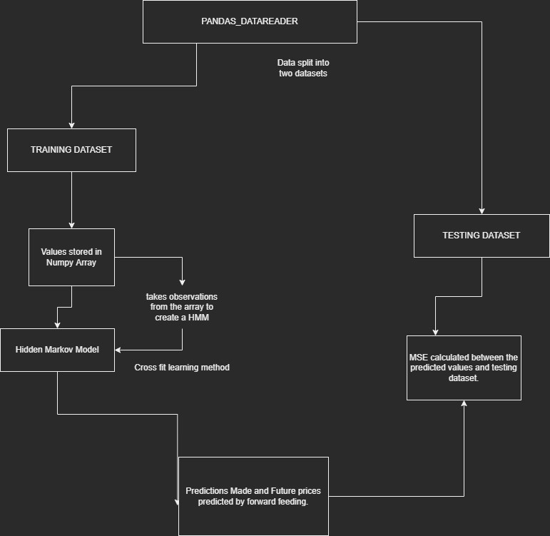
High level Architecture
Notes:
Provide a basic introduction of the project and also an overview of scope it entails.
Set the context.

Slide 5
Proposed Approach
Stock market data is downloaded via pandas_datareader and the data is split into training and testing datasets. The fractional changes for any given day (from open to close, high to open, open to low) in the training dataset are computed and stored in a NumPy array. These fractional changes can be seen as the observations for the HMM and are used to train the continuous HMM with hmm learns fit method. The model then predicts the closing price for each day in the training dataset, based on the given days opening price. This prediction is found by calculating the highest scoring potential outcome out of a predetermined set of outcomes (e.g., +0.001%, -0.001% etc.).
All predictions as well as the actual close prices for the testing period are stored in an excel file and the Mean Squared Error between the two is printed out. The MSE is also included in the file name for future reference. Future days are predicted by feeding forward the prediction values. Unfortunately, at present there is no method in place to account for overnight/ weekend futures trading, and so for the future predictions the n+1 days open price is the same as the nth days closing price.
Notes:
Provide summary of Phase – 1.
Include the suggestions and improvements made.

Slide 6
Literature Survey
Title of the paper | Year of Publication | Journal/Conference Name | Advantages | Limitations
An innovative neural network approach for stock market prediction | 2020 | Springer/Crossmark | Methods are performing well on Shanghai Index. | Deficiencies in the input of historical data. Stock Market news not fully utilized.
Deep Learning for Stock Market Prediction | 2020 | Entropy | LSTM and HMM are the most accurate measures. | Chinese Stock Market not separable from Western Market.
The applications of artificial neural networks, support vector machines, and long–short term memory for stock market prediction | 2022 | Decision Analytics Journal | Highly Accurate for Result Prediction, Trend Pattern Detection. | Cannot yet relate with data-intensive, noisy, non-stationary, and unstructured and hidden relations.
Notes:
Provide summary of Phase – 1.
Include the suggestions and improvements made.

Slide 7
Literature Survey
Title of the paper | Year of Publication | Journal/Conference Name | Advantages | Limitations
Stock Market Prediction Using Hidden Markov Models | 2012 | IEEE | The approach was compared to HMM-fuzzy model, ARIMA and ANN for stock forecasting. The MAP-HMM model outperforms others for Apple Inc. and IBM Corporation, and has comparable performance for Dell Inc. | We assume that the model for one particular stock is independent of the other stocks in the market, however in reality these stocks are heavily correlated to each other and, to some extent, to stocks in other markets too
Stock Forecasting using Hidden Markov Processes | 2009 | Stanford | Use of double HMM which runs the Markov Chain of the economic states separately, which gives model more degree of freedom. As a result, we can verify that the Double HMM can predict better than the Single HMM and its transition matrix verifies the effectiveness of Double HMM. | Double HMM performs better than the Single HMM when the number of states is the same. Also, 3 states case performs better than the case of 5 states. This is possible because larger number of states is generating fine many states which cause higher peaks and this leads poor predictability
Stock Market Trend Analysis Using Hidden Markov Models | 2013 | arXiv.org | It is observed that at any point of time over years, if the stock market behaviour pattern is the same then we can observe the same steady state probability values as obtained in one day difference of close value, which clearly determines the behavioural pattern of the stock market. | The main problems of HMM are: Evaluation, Decoding, and Learning which are relatively difficult to solve with general approaches and have to be solved with approaches such as Forward Backward Algorithm, Viterbi Algorithm and Buaum Welch algorithm which is considered as the traditional method for training HMM.
Notes:
Provide summary of Phase – 1.
Include the suggestions and improvements made.

Slide 8
Title of the paper | Year of Publication | Journal/Conference Name | Advantages | Limitations
A Study of Hidden Markov Model | 2004 | TRACE: Tennessee Research and Creative Exchange | When looking more closely at the predictions of the HMM and its fractal dimension, it can be concluded that the HMM is able to capture the chaotic characteristics of the time-series. | It can be observed that when the stock is worth the least, the predicted price is relatively too volatile. This might be due to the smaller size of training data.
Stock prediction using a Hidden Markov Model versus a Long Short-Term Memory | 2019 | University of Groningen | When looking at the results it can be observed that the HMM had a better performance compared to the LSTM. The MAPE and the RMSE for the prediction of the HMM was lower than LSTM. | However, it only predicted the correct direction of the price 50% of the time, which is not better than random guess. This also goes for the LSTM, which predicts the price direction correct 51% of the time.
Algorithmic Trading Based on Hidden Markov Models | 2016 | University of GothenBerg | The static and the dynamic HMM trading algorithms can earn risk-adjusted excess return during limited time frames. An important aspect to consider is that HMMs depend on patterns in historical data that can be found again in future data. | It could not be concluded that the type of HMMs used in this study could perform better than random guesses of future price movements of OMXS30. Furthermore, it could not be concluded that the two trading algorithms developed in the study could generate risk-adjusted returns over time.
Literature Survey
Notes:
Provide summary of Phase – 1.
Include the suggestions and improvements made.

Slide 9
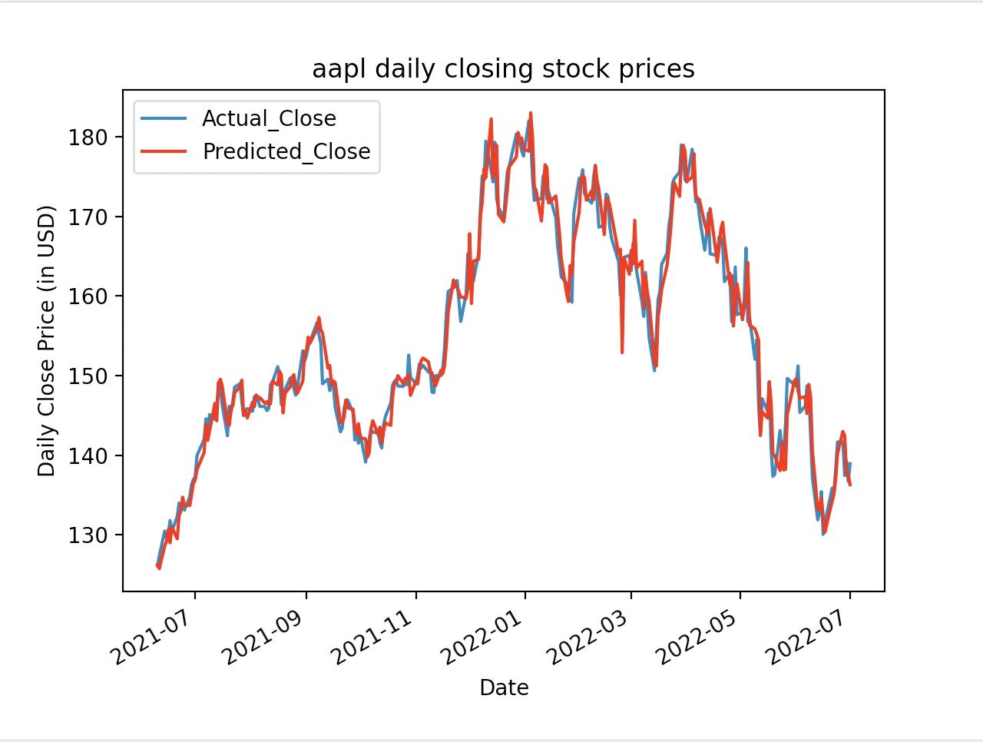
Results and Discussion
Notes:
Provide summary of Phase – 1.
Include the suggestions and improvements made.

Slide 10
References
Historical Data –
https://quantquote.com/historical-stock-data Description of Technical Analysis -
http://www.investopedia.com/terms/t/technicalanalysis.asp Berkeley paper on ANN-based analysis
http://www.cs.berkeley.edu/~akar/IITK_website/EE671/report_stock.pdf
Efficient Market Hypothesis - http://www.e-m-h.org/Fama70.pdf
Finding anomalies in time series – https://blog.twitter.com/2015/introducing-practical-and-robust-anomaly-detection-in-a- time-series
Scale: The universal laws of growth –
http://www.penguinrandomhouse.com/books/314049/scale-by-geoffreywest/9781594205583/
Nonparametric Econometrics: A Primer – http://socserv.mcmaster.ca/racine/ECO0301.pdf
An Investigation into the Use of Reinforcement Learning Techniques within the Algorithmic Trading Domain –
http://www.doc.ic.ac.uk/teaching/distinguished-projects/2015/j.cumming.pdf Technical Analysis –
http://www.mrao.cam.ac.uk/~mph/Technical_Analysis.pdf
An empirical analysis of algorithmic trading on financial markets –
http://lib.ugent.be/fulltxt/RUG01/001/315/567/RUG01-001315567_2010_0001_AC.pdf
Notes:
Provide summary of Phase – 1.
Include the suggestions and improvements made.

Slide 11
Thank You

